Slide 1
Solid State Chemistry
Power point presentation prepared by:
Dr. Ambika Kumar
Asst. Professor (Dept. of Chemistry)
B. N. College Bhagalpur
Contact (whatsApp) no. 7542811733
e-mailID: kumarambika.1115@gmail.com
References:
https://www.tf.uni-kiel.de/matwis/amat/def_en/kap_2/basics/b2_1_6.html
https://www.toppr.com/ask/question/derive-braggs-equation/
https://www.slideshare.net/GOVINDARAJP6/solid-state-chemistryppt

Slide 3
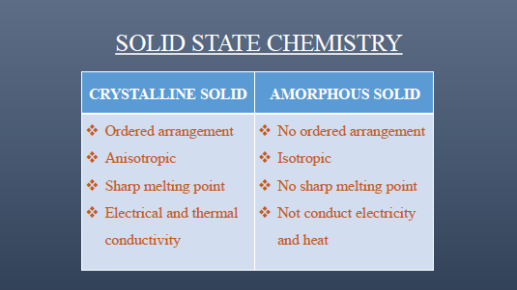

Slide 5
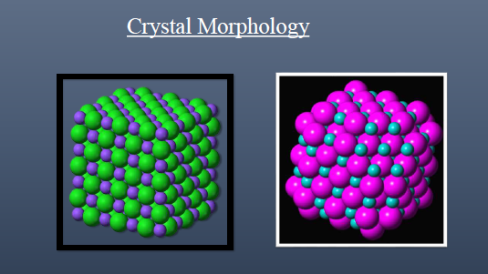

Slide 30
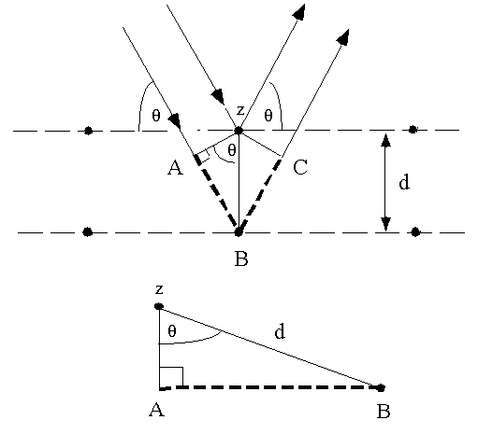
Derivation of Bragg’s Equation:
The phases of the beams coincide when the incident angle equals reflecting angle. The rays of the incident beam are in phase and parallel upto point z, which is the point at which top beam strikes the top layer. The second beam passes to next layer and is scattered by B. The second beam travels extra distance AB + BC. This extra distance is an integral multiple of the wavelength.
nλ=AB +BC.
ButAB =BC
hence, nλ=2AB.....................(1) d is the hypotenuse of the right triangle
Abz. Ab is opposite to angle θ
AB=dsinθ.................(2)
Substitute equation (2) in equation (1)
nλ=2dsinθ
This is equation for Bragg's law

Slide 37
The Laue method
The Laue method is mainly used to determine the orientation of large single crystals. White radiation is reflected from, or transmitted through, a fixed crystal.
The diffracted beams form arrays of spots, that lie on curves on the film. The Bragg angle is fixed for every set of planes in the crystal. Each set of planes picks out and diffracts the particular wavelength from the white radiation that satisfies the Bragg law for the values of d and q involved. Each curve therefore corresponds to a different wavelength. The spots lying on any one curve are reflections from planes belonging to one zone. Laue reflections from planes of the same zone all lie on the surface of an imaginary cone whose axis is the zone axis.

Slide 38
There are two practical variants of the Laue method,
The back-reflection and
The transmission Laue method.

Slide 39
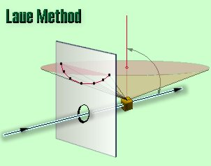
Back-reflection Laue
In the back-reflection method, the film is placed between the x-ray source and the crystal. The beams which are diffracted in a backward direction are recorded.
One side of the cone of Laue reflections is defined by the transmitted beam. The film intersects the cone, with the diffraction spots generally lying on an hyperbola.

Slide 40
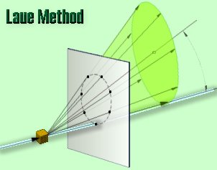
Transmission Laue
In the transmission Laue method, the film is placed behind the crystal to record beams which are transmitted through the crystal.
One side of the cone of Laue reflections is defined by the transmitted beam. The film intersects the cone, with the diffraction spots generally lying on an ellipse.

Slide 41
Crystal orientation is determined from the position of the spots. Each spot can be indexed, i.e. attributed to a particular plane, using special charts. The Greninger chart is used for back-reflection patterns and the Leonhardt chart for transmission patterns.
The Laue technique can also be used to assess crystal perfection from the size and shape of the spots. If the crystal has been bent or twisted in anyway, the spots become distorted and smeared out.

Slide 47
Note: Many salts and oxides have this structure, e.g. KCl, AgBr, KBr, PbS, MgO, FeO, etc.

